Slide 1
Android Accessibility
My Spectrum App – 11/05/2018
-Saamer Mansoor @saamerm

Slide 2
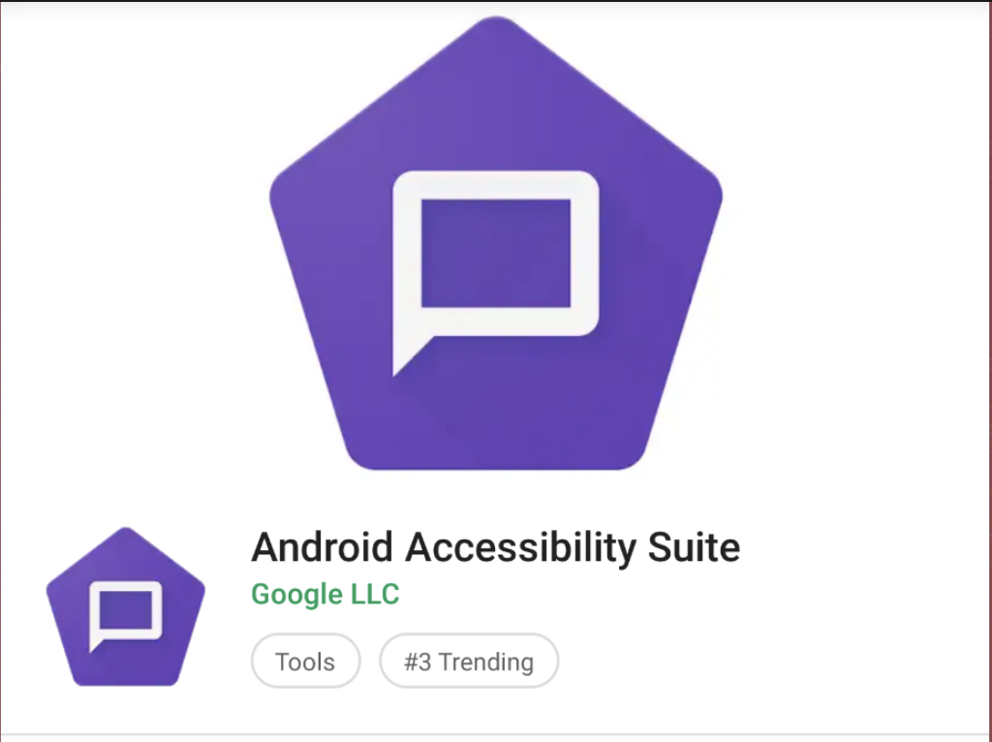
TALKBACK Activation
Rebranded as “Android Accessibility Suite” on June 21, 2018
Download “Android Accessibility Suite” app from Play Store:
Then go to Settings and Turn Talkback On. Note that it may look different than what you see on the right->

Slide 3
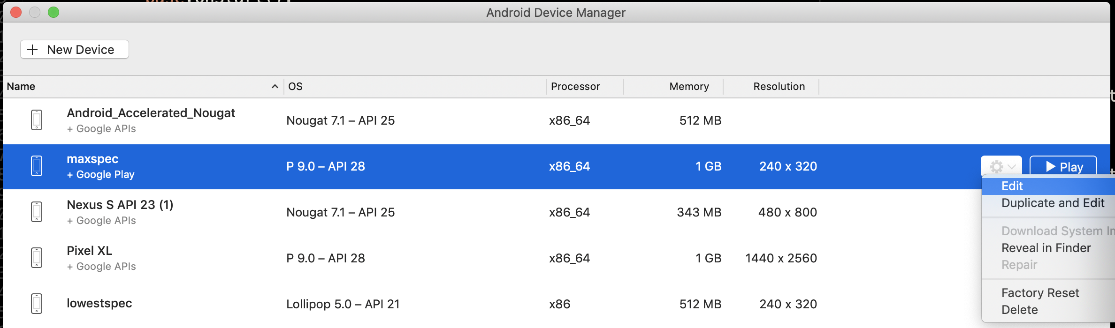
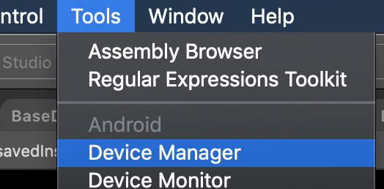
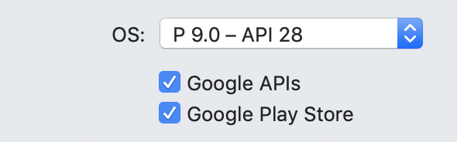
TALKBACK on Emulator
And then follow instructions from the previous slide, to download Talkback from the Android Play Store on the Emulator device.
Notes:
You can build your app in order to launch the emulator, and then

Slide 4
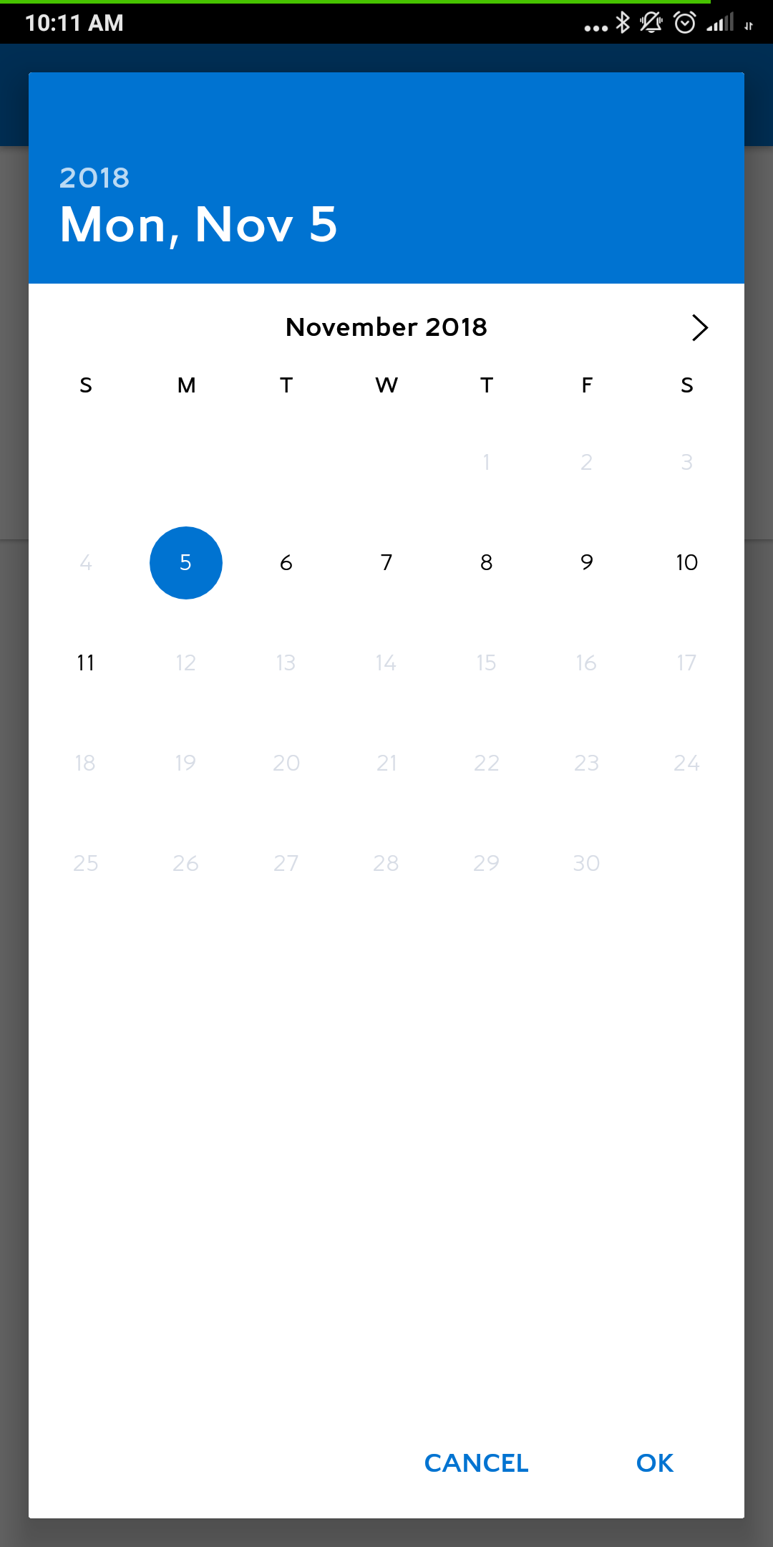
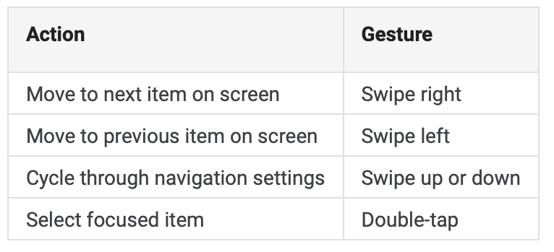
BASIC GESTURES

Slide 5
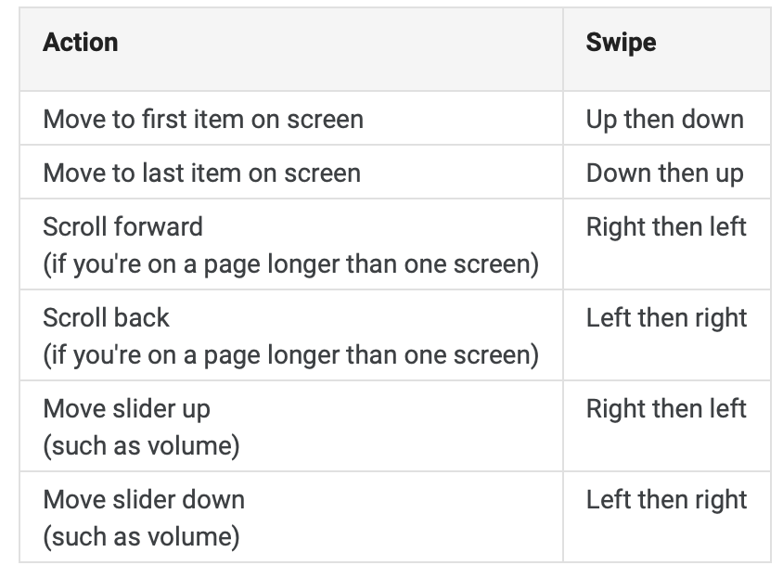
Back & Forth Gestures

Slide 6
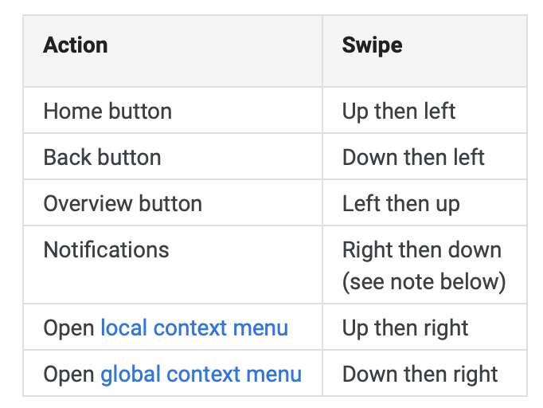
(Right) Angle GESTURES
These gestures are two-part swipes at a right angle. For example, the default gesture for going to the Home screen is to swipe up then left at a sharp 90-degree angle.
Note: The Notifications gesture (right then down) is available only in some TalkBack versions. If this gesture doesn't work for you, use a two-finger swipe down from the top of the screen to open the notifications shade.

Slide 7
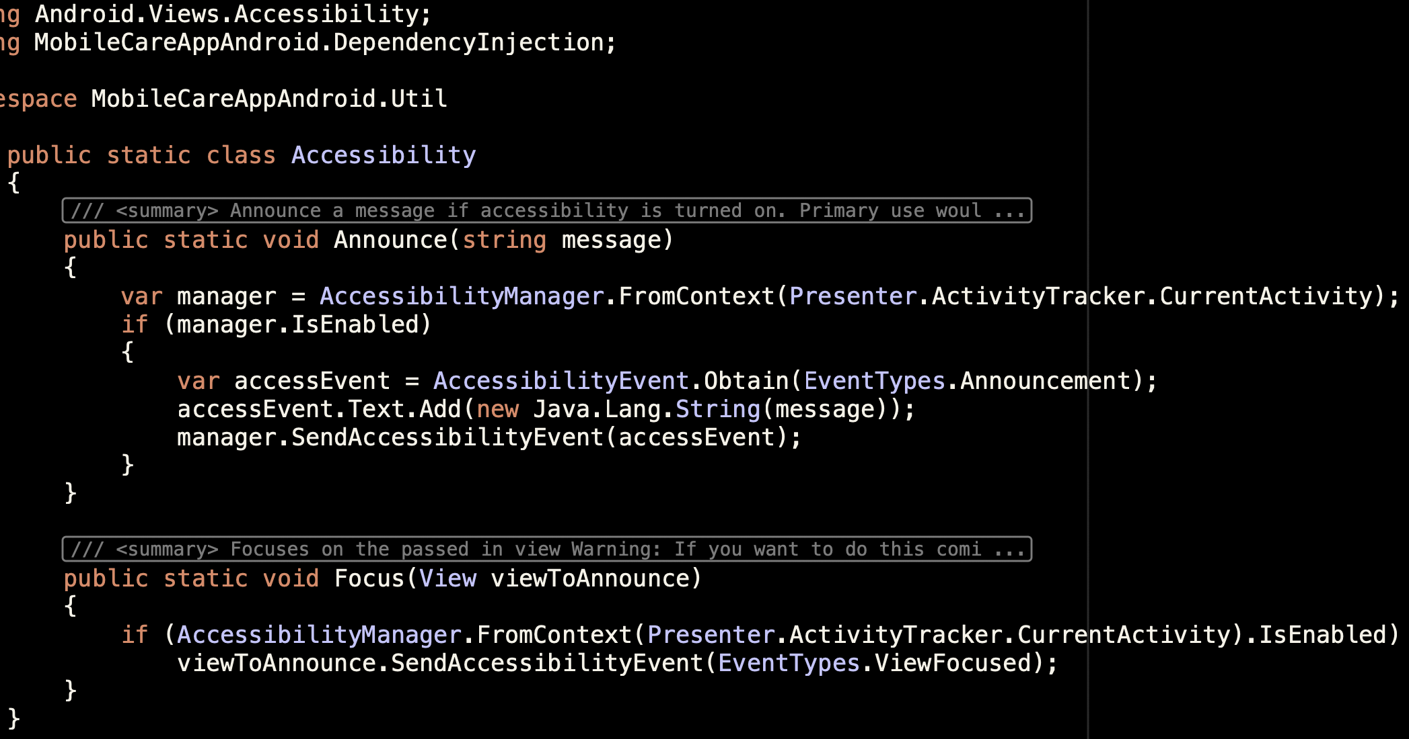
Focus and Announce
Accessibility Utility class to be used:

Slide 8
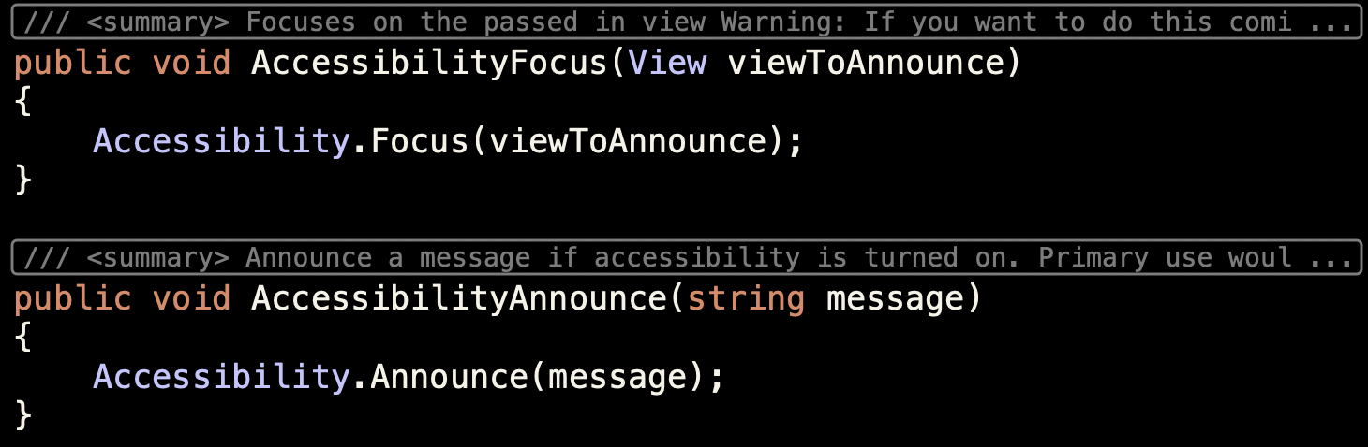
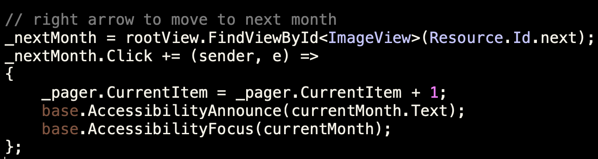
Focus and Announce
BaseDialogFragment implementation uses the Accessibility Utility class:
CalendarDialogFragment’s OnCreateView “>” button:
Now on moving to the next month, talkback focuses and announces November 2018
Notes:
Generally accessibility code is added in the OnCreateView or OnCreate functions

Slide 9
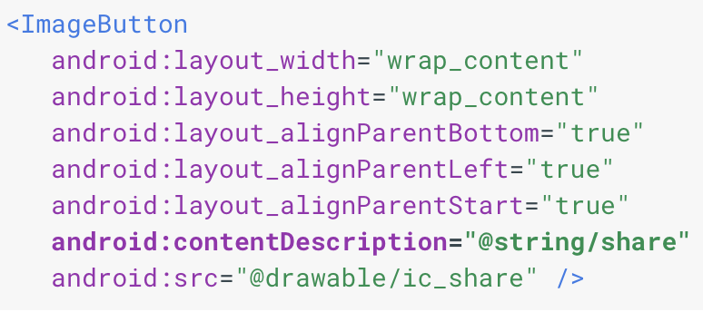
Content Description
Done inside OnCreateView() Now, focusing on the next button doesn’t say “Unlabeled button”, it says ”Next Month, button”
For non-Android devs, you can also edit attributes in the axml layout:
Notes:
Can

Slide 10
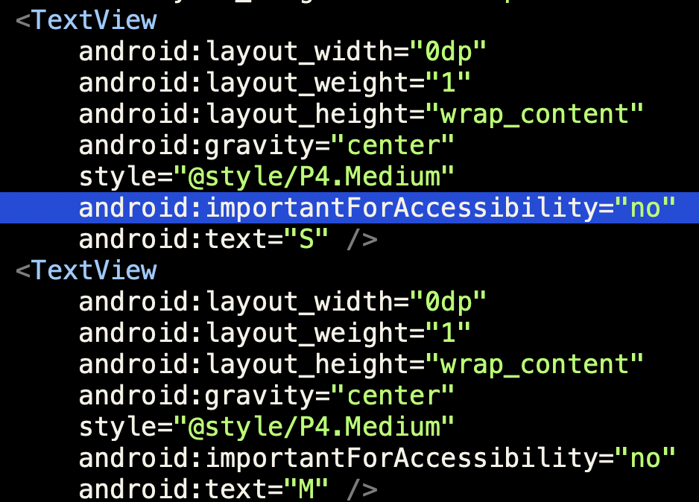
ReQUIRED FOR ACCESSIBILITY
Focusability and FocusedByDefault didn’t seem to do anything useful for talkback.
Hint attribute is to tell the user the type of control, eg: button. “Next Month, button”
CalendarDialogFragment.axml layout:
Now, when you scroll after the “>” button, it skips all the days of the month.
As shown, in the previous slide, you can edit the attributes of the controls in C# as well

Slide 11
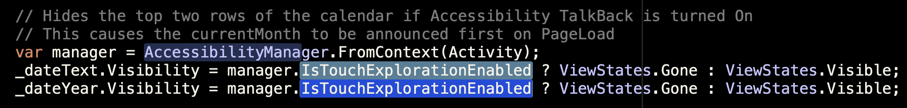
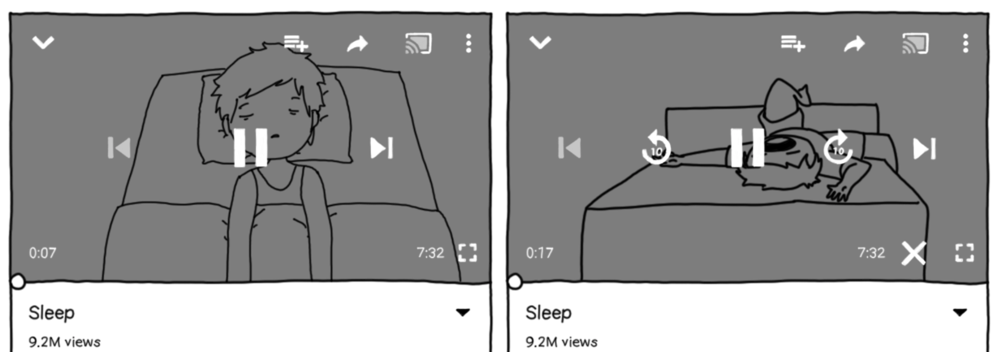
Accessibility Manager
Checks the context for accessibility information, and implement accessibility specific UI behavior, within OnCreateView()
Accessibility Off Accessibility On
<-YouTube app example of different experiences for accessibility users
Notes:
Context-Interface to global information about an application environment.. https://proandroiddev.com/whats-next-a-practical-introduction-to-accessibility-on-android-79c90d27e124

Slide 12
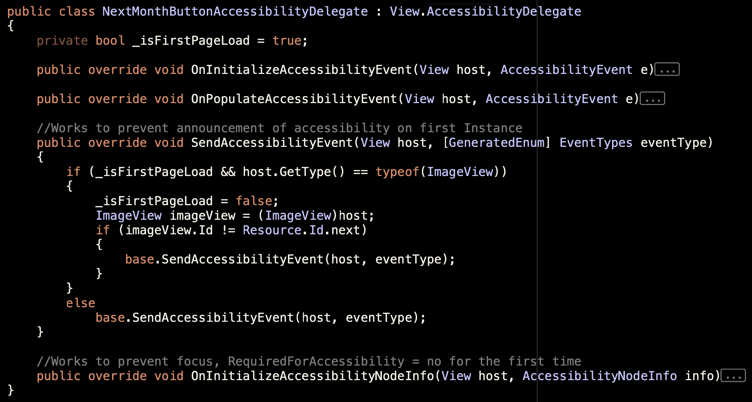
Accessibility Delegate
Override the existing AccessibilityDelegate of a button/image/label control within the OnCreateView() :
Add the AccessibilityDelegate within the same CalendarDialogFragment class at the bottom.
Overriding each of those, can be useful in a certain way, SendAccessibilityEvent() and OnInitializeAccessibilityNodeInfo() were useful for our testing as you can see the

